Slide 1
Factory Automation and Control Methods
Lecture 1: Introduction
Daro VAN
Paragon International University
Faculty of Engineering
Department of Industrial Engineering

Slide 2
Outline
Production systems
Automation in production systems
Manual labor in production systems
Automation principles and strategies

Slide 3
1. Production Systems
“A collection of people, equipment and procedures organized to accomplished the manufacturing operations of a company ”
Two major components:
Facilities – the factory, equipment in the facility and the way the facility is organized ( plant layout)
Manufacturing support systems – the set of the procedures used by the company to manage production and to solve technical and logistics problems in ordering materials, moving work through the factory, and ensuring that product meet quality standards

Slide 4
1. Production Systems
Manufacturing Systems
Facilities
Factory and plant layout
Production System
Product Design
Manufacturing planning
Manufacturing support systems
Manufacturing Control
Business functions

Slide 5
1. Production Systems 1.1 Facilities
Facilities include the factory, production machines and tooling, material handling equipment, inspection equipment, and computer systems that control manufacturing operations.
Plant layout – the way the equipment is physically arranged in the factory
Manufacturing systems – logical groupings of equipment and workers in the factory
Ex. Single production machine, collection of machine and workers….

Slide 6
1. Production Systems 1.1 Facilities
Three categories in terms of the human participation in the processes performed by the manufacturing systems
Manual work systems – a worker performing one or more tasks without aid of powered tools, but sometimes using hand tools (Ex. Screwdriver, hammers...)
Worker-machine systems – a worker operates powered equipment (Ex operating lathe machine)
Automated systems – a process performed by a machine without direct participation of a human worker

Slide 7
1. Production Systems 1.1 Facilities
A manual work systems consists of one or more workers performing one or more tasks without the aid of powered tools.
Worker
Hand tools often used
Start
working unit
Process
Completed
work unit

Slide 8
1. Production Systems 1.1 Facilities
Worker-machine systems: A human worker operates a powered machine, such as a machine tool or other production machine.
Worker
Machine
Start
working unit
Process
Completed
work unit

Slide 9
1. Production Systems 1.1 Facilities
Automated systems : the process is performed by a machine without direct participation of a human worker.
Automated machine
Periodic worker attention
Start
working unit
Process
Completed
work unit

Slide 10
1. Production Systems 1.1 Facilities
Automated Systems
A semi automated machine performs a portion of the work cycle under some form of program control, and a human worker tends to the machine for the remainder of the cycle, by unloading and loading it, or performing some other task each cycle.
A fully automated machine has the capability to operate for extended periods of time with no human attention.

Slide 11
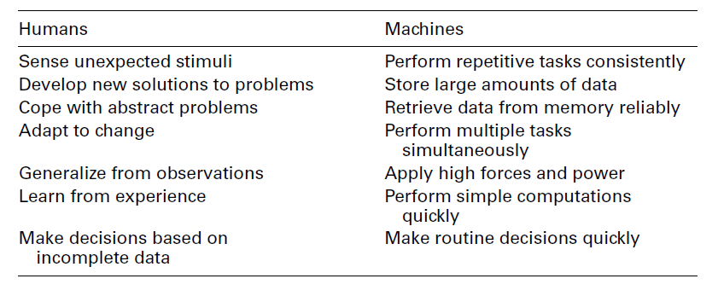
1. Production Systems 1.1 Facilities

Slide 12
1. Product Systems 1.2 Manufacturing Support Systems
“ People and procedures by which a company manages its production operations”
Design the process and equipment
Plan and control the production orders
Satisfy product quality requirements

Slide 13
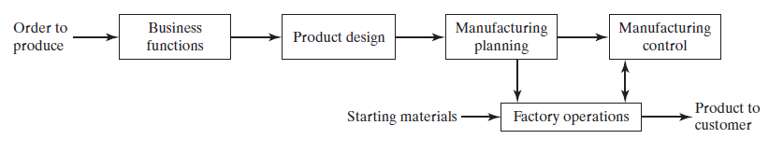
1. Product Systems 1.2 Manufacturing Support Systems
From Mikell Fig 1.3
Sequence of Information-processing activities in a typical manufacturing firm

Slide 14
1. Product Systems 1.2 Manufacturing Support Systems
Business functions : principal means of communicating with customers. It includes sales, marketing, sale forecasting, order entry, customer billing ….
Ex. The production order will be one of the following forms:
an order to manufacture an item to the customers’ specifications
a customer order to buy manufacturer’s product
an internal company order based on a forecast of future demand

Slide 15
1. Product Systems 1.2 Manufacturing Support Systems
Production design – research and development, design engineering, prototype shop
Product is manufactured to customer design
Product has to be produced to customer specification
Product is designed and prototyped (proprietary)

Slide 16
1. Product Systems 1.2 Manufacturing Support Systems
Manufacturing planning – the information and documentation that constitute the product design flows into the manufacturing planning function
Process planning: consists of determining the sequence of individual processing and assembly operations needed to produce part
Master Production Schedule (MPS) is the listing of the products to be made, the dates on which they are to be delivered, and the quantities of each
Materials Requirement Planning (MRP): planning of individual components and subassemblies that make up each component
Capacity planning is concerned with manpower and machine resources of the firm

Slide 17
1. Product Systems 1.2 Manufacturing Support Systems
Manufacturing control – concerned with managing and controlling the physical operations in the factory to implement the manufacturing plans
Shop floor control deals with the problem of controlling the progress of the product as it is being processed, assembled, moved and inspected in the factory
Inventory control attempts to strike a proper balance between the risk of too little inventory and the carrying cost of too much inventory. (when and what to order)
Quality control ensures that the quality of product and its components meet the standards specified by the product designer.

Slide 18
2. Automation in Production Systems
Two categories of automation in the production systems:
Automation of manufacturing systems in the factory
Computerization of the manufacturing support systems
The two categories overlap because manufacturing support systems are connected to the factory manufacturing systems.

Slide 19
2. Automation in Production Systems 2.1 Automated Manufacturing Systems
Processing
Assembly
Inspection
Material handling
They are called automated because they perform their operations with a reduced level of human participation compared with the corresponding process (sometimes virtually no human participation).

Slide 20
2. Automation in Production Systems 2.1 Automated Manufacturing Systems
Example
Automated machine tools
Transfer lines that performs a series of machine
Automated assembly systems
Industrial robots that perform processing or assembly operations
Automated material handling and storage systems to integrated manufacturing operations
Automatic inspection system for quality control

Slide 21
2. Automation in Production Systems 2.1 Automated Manufacturing Systems
Three basic types:
Fixed automation
Programmable automation
Flexible automation

Slide 22
2. Automation in Production Systems 2.1 Automated Manufacturing Systems
Fixed Automation
“A manufacturing system in which the sequence of processing (or assembly) operations is fixed by the equipment configuration”
Typical features:
Suited to high production quantities
High initial investment for custom-engineering equipment
High production rates
Relatively inflexible in accommodating product variety

Slide 23
2. Automation in Production Systems 2.1 Automated Manufacturing Systems
Fixed automation
The economic justification for fixed automation is found in products that are produced in very large quantities
Transfer lines
Automated assembly lines

Slide 24
2. Automation in Production Systems 2.1 Automated Manufacturing Systems
Programmable Automation
“A manufacturing system designed with the capability to change the sequence of operations to accommodate different product configurations”
Typical features:
High investment in general purpose equipment
Lower production rates than fixed automation
Flexible to deal with variations and changes in production configuration
Most suitable for batch production
Physical setup and part program must be changed between jobs (batches)

Slide 25
2. Automation in Production Systems 2.1 Automated Manufacturing Systems
Programmable Automation
The operation sequence is controlled by a program, which is a set of instructions coded so that they can be read and interpreted by the system.
New programs can be prepared and entered into equipment to prepare new products.
Numerically control (NC) machine tools
Industrial robots
Programmable logic controllers

Slide 26
2. Automation in Production Systems 2.1 Automated Manufacturing Systems
Flexible Automation
“An extension of programmable automation in which the system is capable of changing over from one job to the next with no lost time between jobs”
Typical features:
High investment for custom-engineered system
Continuous production of variable mixes of products
Medium production rates
Flexibility to deal with soft product variety

Slide 27
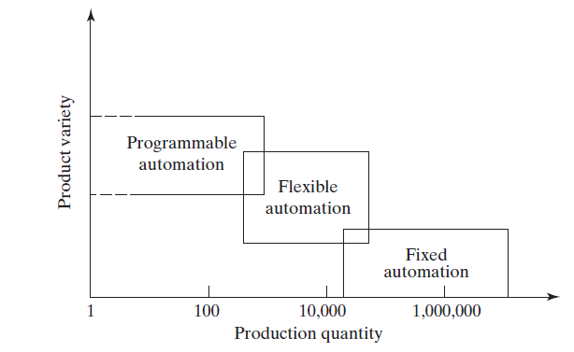
2. Automation in Production Systems 2.1 Automated Manufacturing Systems
From Mikell Fig 1.5
Three types of automation relative to production quantity and product variety

Slide 28
2. Automation in Production Systems 2.2 Computerized Manufacturing Support Systems
Automation of the manufacturing support system is aimed at reducing the amount of manual and clerical in product design, manufacturing planning and control and the business function of the firm.
Computer-integrated manufacturing (CIM): Involves information-processing activities—business function, product design, manufacturing planning, manufacturing control
Computer-aided design (CAD): Fusion 360, SolidWorks, Catia,…
Computer-aided manufacturing (CAM): FastCAM,…

Slide 29
2. Automation in Production Systems Reasons for Automating
To increase labor productivity
To reduce labor cost
To mitigate the effect of labor shortages
To reduce or remove routine manual or clerical tasks
To improve worker safety
To improve product quality
To reduce manufacturing lead time
To accomplish what cannot be done manually
To avoid the high cost of not automating

Slide 30
3. Manual Labor in Production Systems
Is there a place for manual labor in the modern production systems? YES but why YES?
Two aspects
Manual labor in factory operations
Labor in manufacturing support systems

Slide 31
3. Manual Labor in Production Systems 3. 1 Manual Labor in Factory Operation
The long term trend is toward greater use of automated systems to substitute for manual labor
When is the manual labor justified?
Some countries have very low labor rates and automation cannot be justified
Task is too technically difficult to automated
Short product life cycle
Customized product requires human flexibility
To cope with ups and downs in demand
To reduce risk of production failure

Slide 32
3. Manual Labor in Production Systems 3. 1 Labor in Manufacturing Systems
Product designers who bring creativity to the design task
Manufacturing engineering who
Design the production equipment and tooling, and
Plan the production method and routings
Equipment maintenance
Programming and computer operation
Engineering project work
Plant management

Slide 33
4. Automation Principles and Strategies 4.1 The USA Principle
Understanding the existing process
Input/output analysis
Value chain analysis
Charting techniques and mathematical model
Simplify the process
Reduce unnecessary steps and moves
Automate the process
Ten strategies for automation and production systems
Automation migration strategy
Notes:
Applying the USA Principle is a good approach in any automation project. As suggested
previously, it may turn out that automation of the process is unnecessary or cannot be
cost justified after the process has been simplified

Slide 34
4. Automation Principles and Strategies 4.2 Ten Strategies for Automation and Process improvement
Specialization of operations
Combined operations
Simultaneous operations
Integration of operations
Increase flexibility
6. Improved material handling and storage
7. On-line inspection
8. Process control and optimization
9. Plant operations control
10. Computer-integrated manufacturing (CIM)
Notes:
If automation seems a feasible solution to improving productivity, quality, or other
measure of performance, then the following ten strategies provide a road map to search
for these improvements

Slide 35
4. Automation Principles and Strategies 4.2 Automation Migration Strategy for Introduction of new Productions
Phase 1 – Manual production
Single-station manned cells working independently
Advantages: quick to set up, low-cost tooling
Phase 2 – Automated production
Single-station automated cells operating independently
As demand grows and automation can be justified
Phase 3 – Automated integrated production
Multi-station system with serial operations and automated transfer of work units between stations

Slide 36
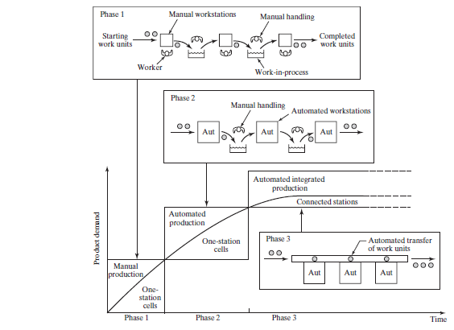

Slide 37
Reference
Mikell P. Groover, “Automation, Production Systems and Computer-integrated Manufacturing” , 4th edition, Pearson

